Slide 1

Airbnb Case Study
Presented by:
Eng.Mostafa Amr Ibrahim

Slide 2
01
Introduction and goals
CONTENTS
02
Tools Used
03
03
Data preparation
04
04
Business insights
05
05
Recommendations
06
Modeling

Slide 3
01
Introduction

Slide 4


Airbnb
Air BNP (Air Business Network Platform) is a specialized digital platform aimed at enhancing the operational efficiency of airlines. By connecting airlines with key stakeholders in the aviation ecosystem. Air BNP facilitates seamless communication and collaboration among various parties.
Title text addition
The user can demonstrate on a projector or computer, or print the presentation and make it film

Slide 5
Goals
Explore and analyize data provided by airbnb
preprocess data and prepare it for modeling and for analysis
drive business insights and Recommendations
train and test the model

Slide 6
02
Tools Used

Slide 7
Tools
Jupyter Notebook For preparation and Modeling
Power Bi for visualizations and Dashboards
Excel for data Storage

Slide 8
03
Data Preparation

Slide 9
Preprocessing
Utilize Python and Jupyter Notebook to preprocess data
Dividing Age to Age groups
Seasonal Grouping
importing pre-processed data to excel
preparing data for the model

Slide 10
04
Business Insights

Slide 11
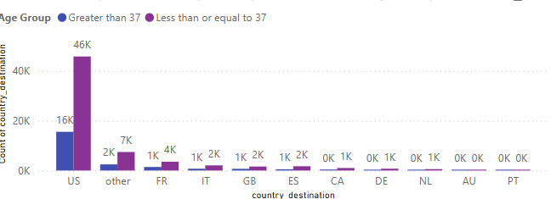
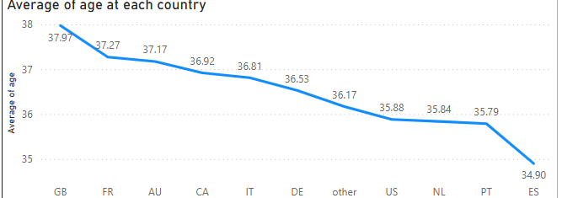
Age
Most of travellers are of the young group which is lower than 37 years old
Customers who do not book tend to not fill up their age
Customers outside US Tend To have slightly higer age

Slide 12
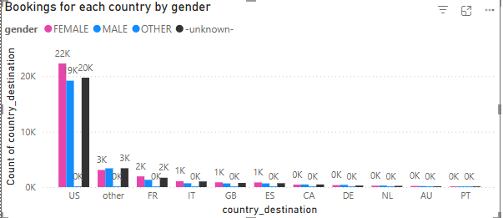
Gender
There is a large portion that wasn’t tracked so their gender was unknown
for all countries there are more females bookings than male except for Denmark, Canada and Netherland

Slide 13
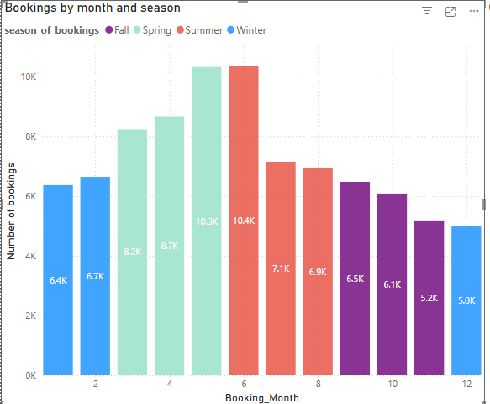
Seasonal Trend
Most of the bookings took place in spring and summer
each country might have it’s own seasonal trends

Slide 14
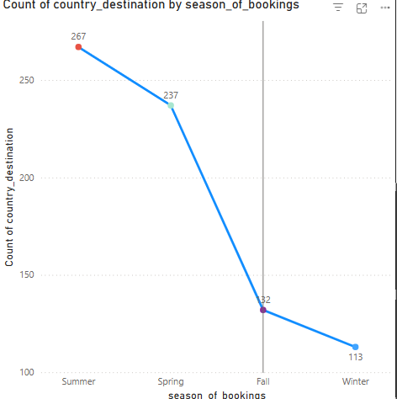
Seasonal Trend
Netherland has most of its visitors come at summer time

Slide 15
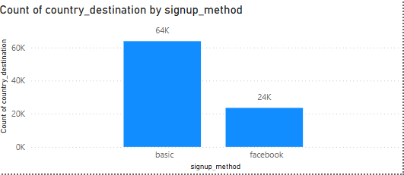
Signup Method
Customers tend to signup more using basic registeration than facebook

Slide 16
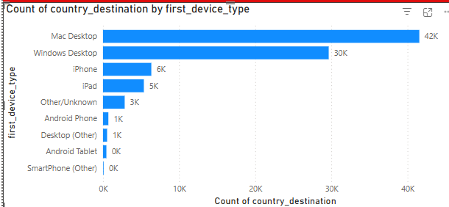
Devices Used
Most of Travellers Use Desktops , macbooks than mobile phones
apple users are more than android users

Slide 17
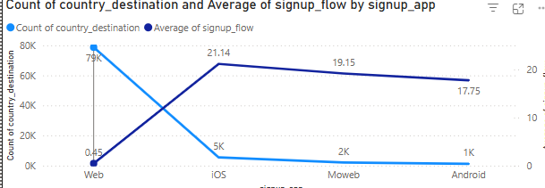
web and apps
signup flow slower on apps than web

Slide 18
Points to investigate
Ipad users more web
Android users web
Iphone users more frequent on the app

Slide 19
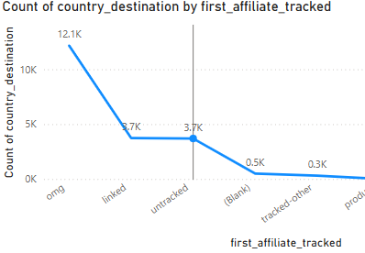

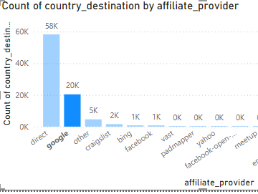
Affiliation
Direct Affiliation
Omg(Online Marketing Groups)
SEM(Search engine marketing) brand vs non brand

Slide 20
05
Recommendations

Slide 21
Age and Gender
Targeted Campaigns for younger people under 37 years old
Targeted campaigns for females
force users to fill up their age before booking as some users travelled but didn’t sign their age
for users above 16 make a new feature to get national id to make it easier to get gender and Age

Slide 22
Bookings locations
Most bookings are inside the US so a service can be provided to get discounts on internal trips with more trips for example 3% discount on first trip and 6 % discount on second trip and 12% discount on third trip for users travelling internally per one year (vip frequent users)
Subscription fees to get such discounts

Slide 23
Seasons
Alot of traffic is in spring and summer so for more profit prices might increase
do more campaigns especially online in that time as users might probably be looking
winter and fall have the lowest bookings so in order to increase bookings at that time contract with hotels to provide luxury services at lower prices in winter and fall
In winter and fall provide discounted trips
for netherland most of the travellers travel at summer so it would be a nice approach to contact resorts at the beach to try to get a discount for travellers

Slide 24
Signup Method
More users tend to regiester by the basic email method rather than facebook so develop a bot to send recent offers to the regiestered emails

Slide 25
Devices and apps vs web
Laptops are more used for bookings so try to enhance user interface through mobile to encourage users to book through the application
Iphone users are the most users to frequently use the the application so provide adds on the application for iphone users suggesting trips and discounts
Investing in enhancing the iOS user experience could yield higher returns
make it more user friendly especially on sigining up as the sign up flow of the app is significantly high
Ipad users use more web than the application try to make the application also suitable for ibad
Android users have alot of bookings through website not this suggests that there is a major problem that has to be fixed on the application to explain why alot of users try to go to web instead of app

Slide 26
Affiliations
Direct Affiliations gives the best results so spend more money contracting with affiliation companies to attract more customers
For affiliations throughout the web services through online adds are provided from companies like google or Bing one of those services is the OMG links
do more campaigns through omg links to the sem-non brand marketing where people might be searching for flights not for The brand itself
use tools like google keyword planner to get what words can be used for that topic without including the brand

Slide 27
05
Modeling

Slide 28
AI model
Use XGboost model to recommend countries to users based on their behaviour
Prepare Data and model parameters

Slide 29
NDCG@5
Traditional accuracy metrics may not be sufficient for ranking-based problems.
NDCG@5 evaluates not only correctness but also the ranking order of predictions.

Slide 30
Results
Model Achieved 86.71 accuracty
model Achieved 0.928 NDCG score

Slide 31
Testing
New testing data has to be processed before being tested
outputs where inverseencoded to be able to get the countries

Slide 32
Thank you for listening

